Slide 2
Hands-On Session: PIRCHE & HLA-EMMA

Slide 3

DR. Cynthia Kramer
Transplantation immunology group
Department of Immunology
Leiden University Medical Centre
E-mail: c.s.m.Kramer@lumc.nl
info@hla-emma.com

Slide 4
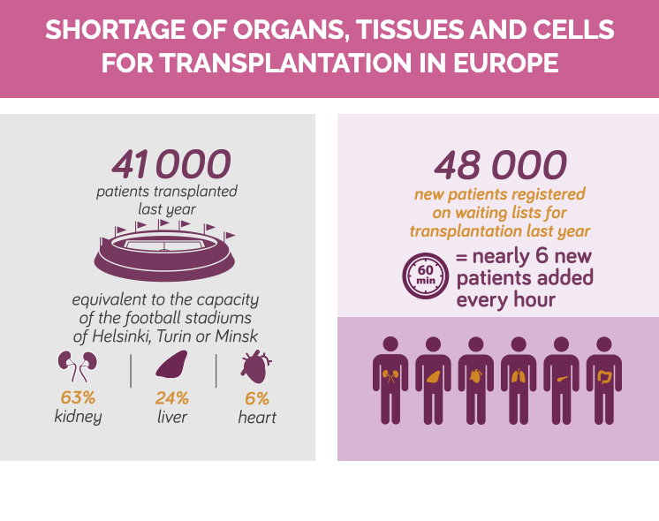
Despite all efforts ….
https://www.coe.int/en/web/human-rights-channel/organ-donation

Slide 5
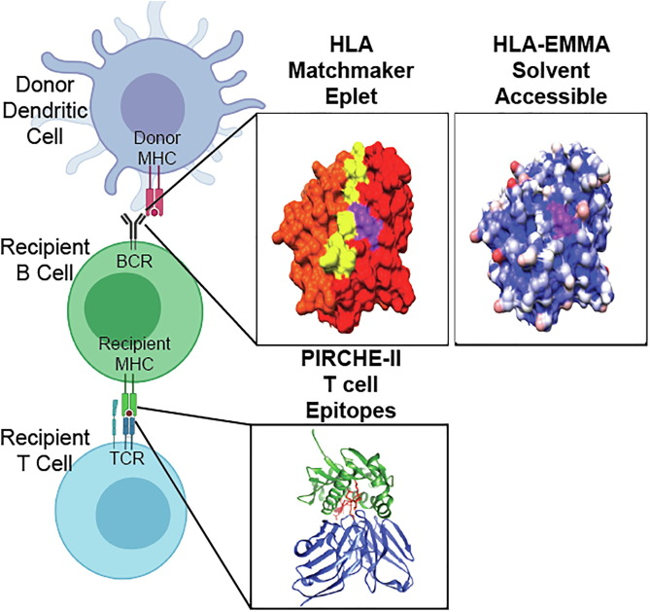
Predicting AB response to MISMATCH HLA

Slide 6
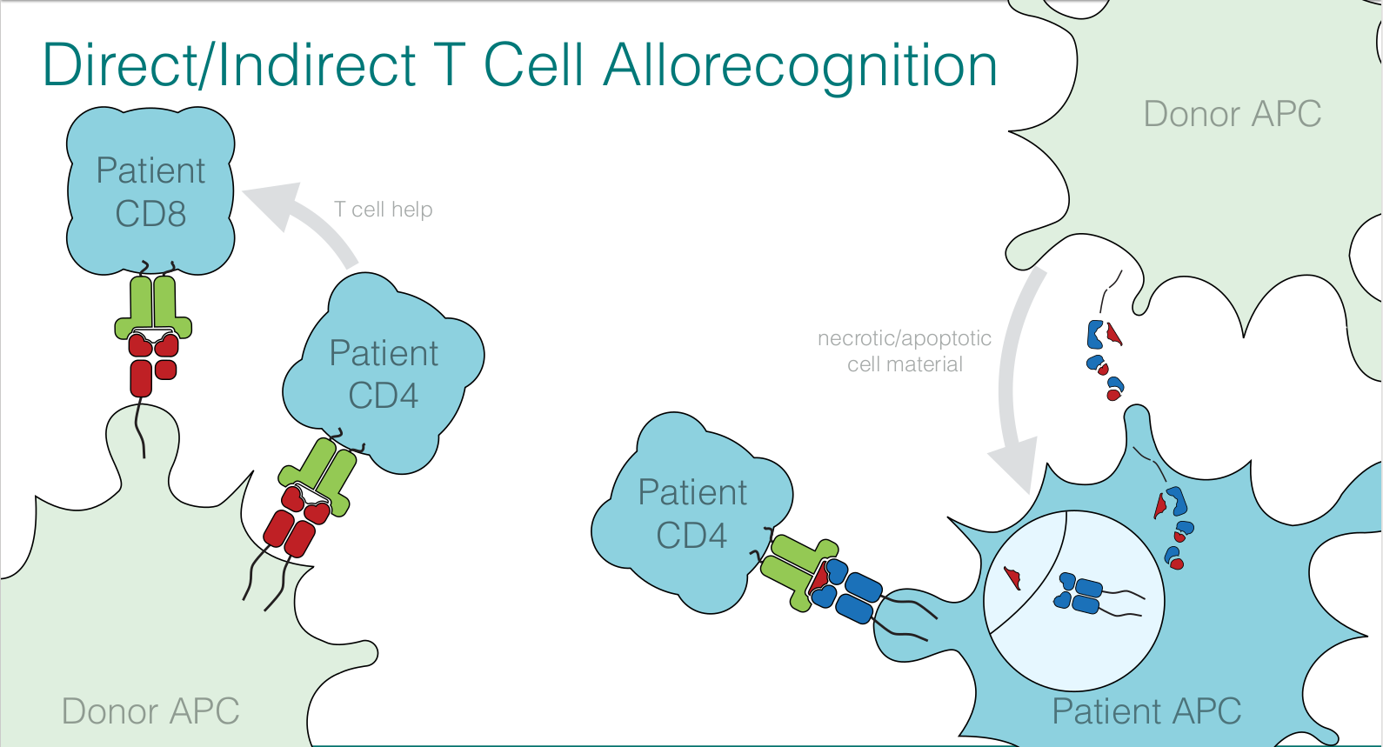
Direct/Indirect T cell recognition of Mismatched HLA
Red=Mismatching HLA

Slide 7
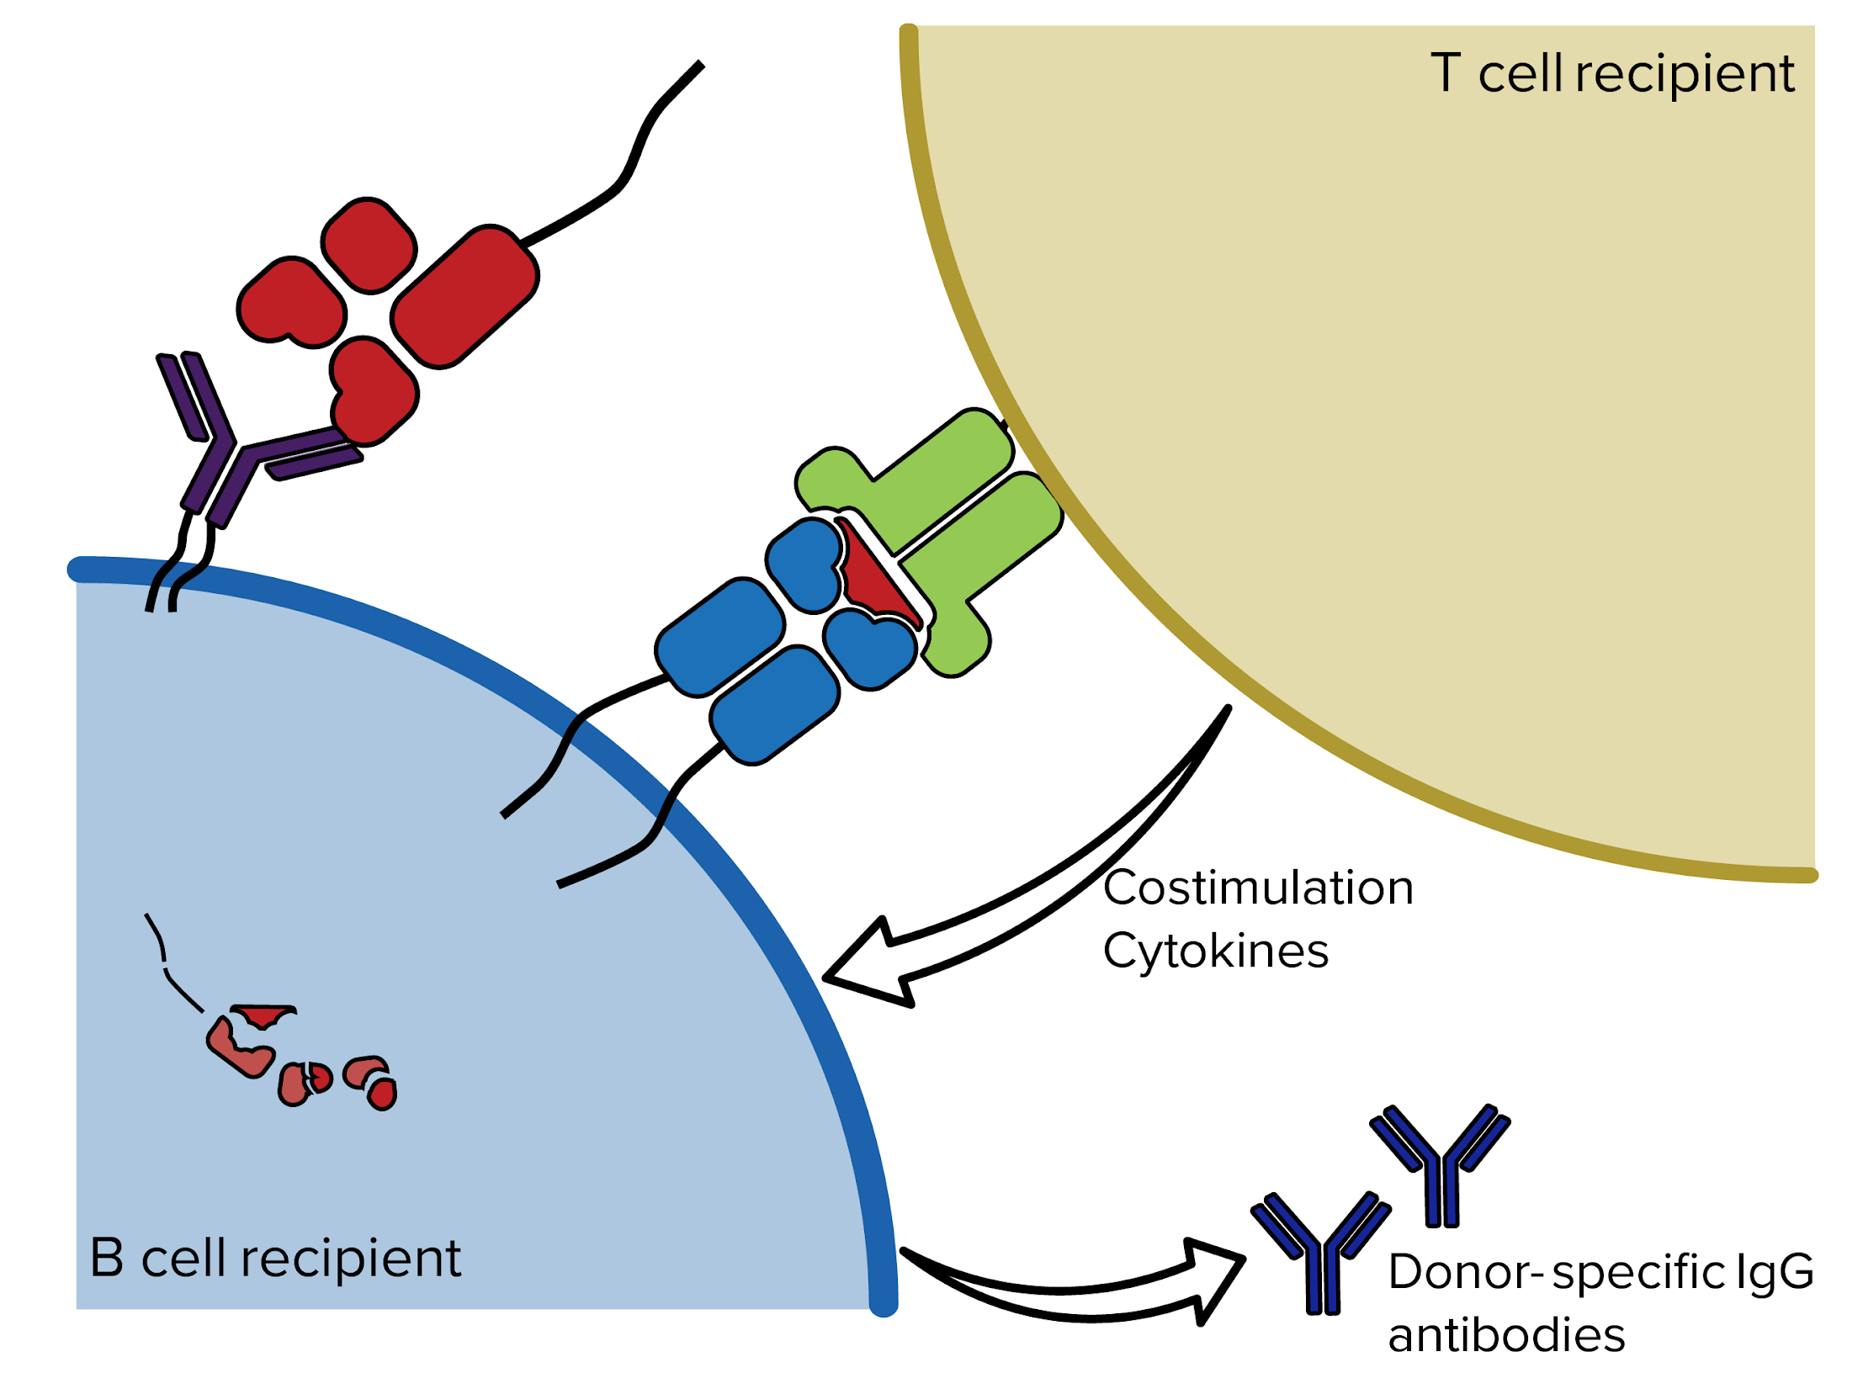



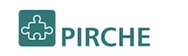
PIRCHE Algortihm to predict T cell Epitopes
PIRCHE = Predicted Indirectly Recognizable HLA Epitopes
→ predicts epitopes due to HLA mismatches
(peptides that differ between host and graft) prior to transplantation
→ high PIRCHE numbers = high risk for alloreactivity
→ In this Tutorial we will focus on PIRCHE-II
Matthias Niemann
Dr. Eric Spierings

Slide 8




STEP 1
Which parts of the HLA mismatch are not present in the HLA of the recipient?
Donor
Recipient
=
🡺
Self peptide
≠
🡺
Non-self peptide

Slide 9
STEP II
Recipient
HLA class II
Donor
Recipient
?
Which parts of the HLA mismatch are not present in the HLA of the Recipient?
Check binding of these parts to recipient HLA class II (NetMHCIIpan).
=
🡺
Self peptide
≠
🡺
Non-self peptide

Slide 10
Functionality of the PIRCHE Program
Available via a web server: pirche.com
Indirect presentation by HLA class I and class II can be done
Available for all populations by including all known HLA alleles
Applicable for analyses of cohorts by incorporating batch analysis option
Providing both the number as well as the sequence of possible T cell epitopes

Slide 11
Predicting AB response to MISMATCH HLA

Slide 12
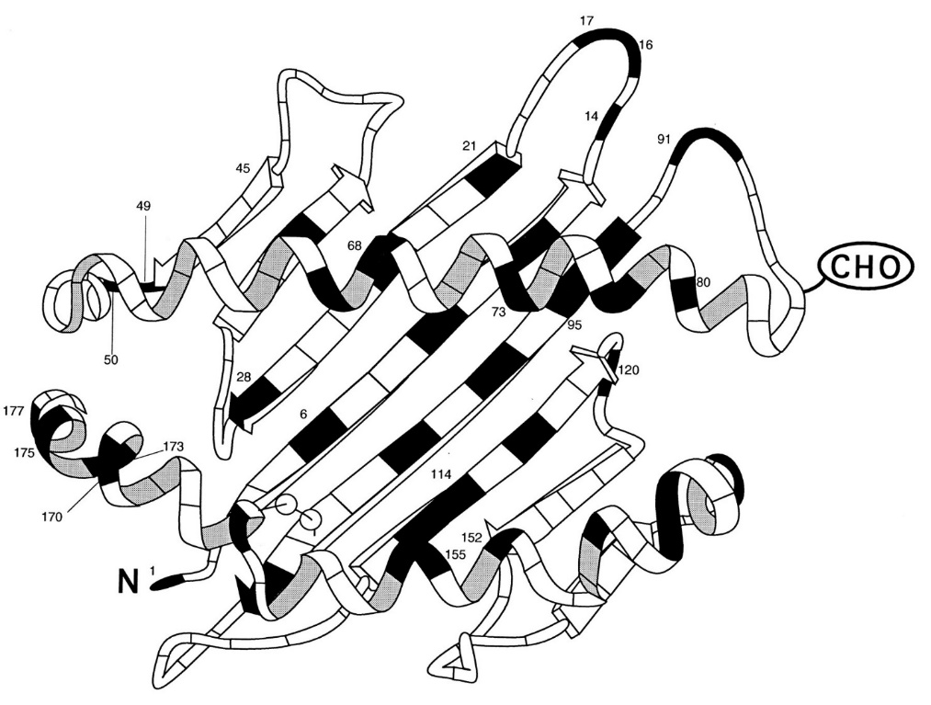
Searching through HLA molecules for possible AB Epitopes
HLA molecules can be compared on the level of individual amino acids
HLA-EMMA identifies mismatching positions between the recipient and the donor HLAs and predicts which mismatches generate possible B cell epitopes
A single surface exposed amino acid mismatch can already be sufficient to induce an antibody response
Low epitope mismatch level do not guarantee low immunogenicity
Notes:
I always show this slide to highlight why we are looking at amino acid level

Slide 13
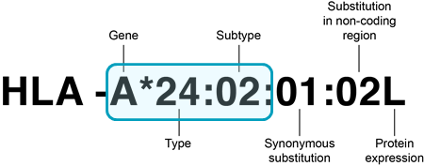

HLA alleles included in HLA-EMMA v1.06
HLA amino acid sequences
All HLA alleles were extracted from the IPD-IMGT/HLA database v3.47 (n= 20.598)
HLA alleles are included up to second field typing resolution
HLA class I amino acid sequence positions: 1 to 275
HLA class II amino acid sequence positions: 1 to 226
HLA typing input preferentially second field
Non-expressed alleles are indicated with N
Not considered for comparison but still included in list of HLA alleles
Option to convert serological typing to most likely second field (population based)
Kramer et al., HLA 2020
Notes:
Important notes: All HLA amino acid sequences of IMGT/HLA v3,47 are included, N alleles are not used for analysis but can still be input, serological can be converted if required

Slide 14
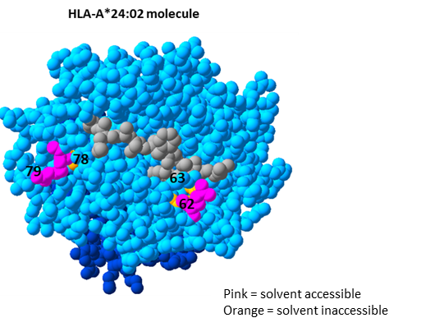
solvent accessible polymorphic amino acid positions
Solvent accessible polymorphic positions indicate that these positions can be accessed by B-cell receptor/antibody
Open source tools (NetSurfP2.0 and Porter Pale4.0) were used to predict the relative solvent accessibility of each position based on HLA crystal structures obtained from RSCB protein data bank
Position was defined as solvent inaccessible if both tools predicted a relative solvent accessibility of <25% for this position on all HLA structures of HLA locus
Polymorphic positions within locus based on all HLA alleles of that locus
Kramer et al., HLA 2020
Notes:
Solvent accessible polymorphic amino acid positions are predicted per locus so that amino acid mismatches can be determined that can potentially be recognised by B cell receptor/antibody.
Figure shows an HLA-A*24:02 molecule in which two solvent accessible positions are highlighted in pink and two positions in orange that are solvent inaccessible

Slide 15
Functionality of HLA-EMMA
A tool to perform compatibility analysis on amino acid level between donor and recipient with focus on solvent accessible amino acid mismatches
Analysis of HLA class I and class II simultaneously
Available for all populations by including all known HLA alleles
Applicable for analyses of large cohorts by incorporating batch analysis option
Providing both the number as well as the position and type of amino acid mismatches
A user-friendly software program
Kramer et al., HLA 2020

Slide 16
HLA-EMMA information
For all information on HLA-EMMA go to: https://hla-emma.com/
Available on the website:
Download button to install HLA-EMMA on your personal computer (Microsoft windows only)
Temporary license for EFI
Background information
Batch template for batch analysis
Instruction manual
Analysis manual on how to perform the analysis both by case and by batch
If you have any question on analysis and background information please send an e-mail to: c.s.m.Kramer@lumc.nl
If you have questions about installing software and license send an email to: info@hla-emma.com

Slide 17
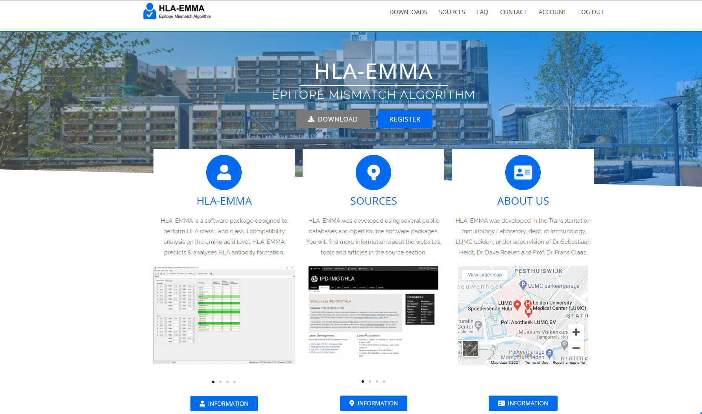
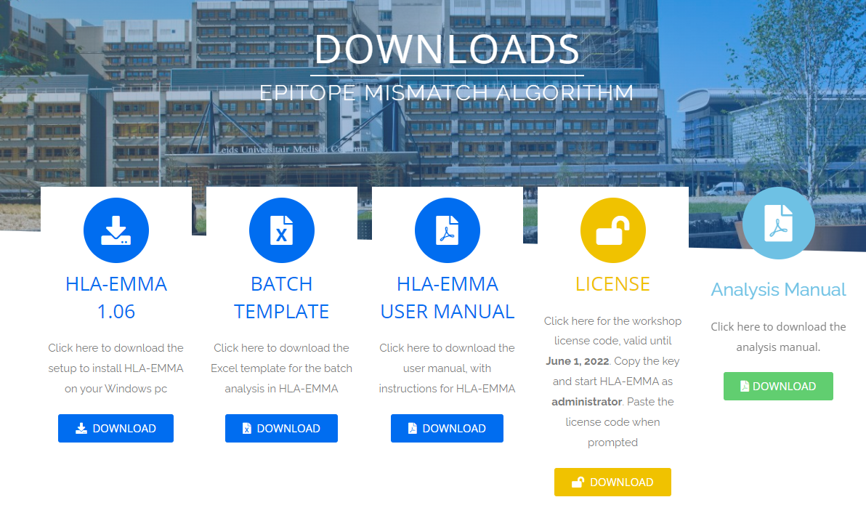
https://hla-emma.com/

Slide 18
GitHub repository
htttps://github.com/bmatern/epitope-demo

